Slide 1
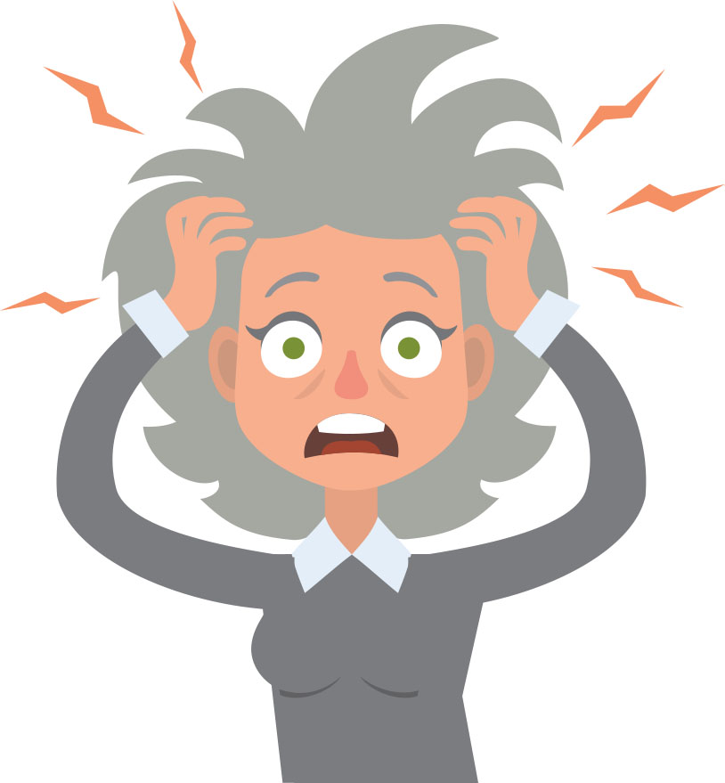

STRESS MANAGEMENT

Slide 2
What is Stress?
Stress: Stress is the reaction people have to excessive pressures or other types of demand placed upon them. It arises when they worry that they can’t cope.
One may feel; worry, tense, tired, frightened, elated, depressed, anxious, anger etc.
Coping: The ability to maintain control, think rationally, and solve problems.

Slide 3

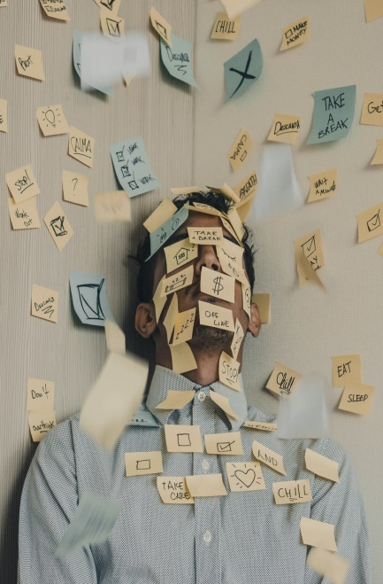

STRESS
Anything that poses a challenge or threat to our well-being.
Emotional and physical response to demanding situations
Helps in completing day to day tasks and in dealing with demands of life.
A little bit of stress – Alert and productive
Too much stress – Serious physical, emotional, and behavioral symptoms

Slide 4
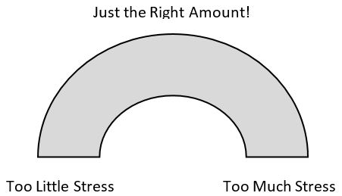
Moderate levels of stress may actually improve performance and efficiency Too little stress may result in boredom Too much stress may cause an unproductive anxiety level
Is All Stress Bad?

Slide 5
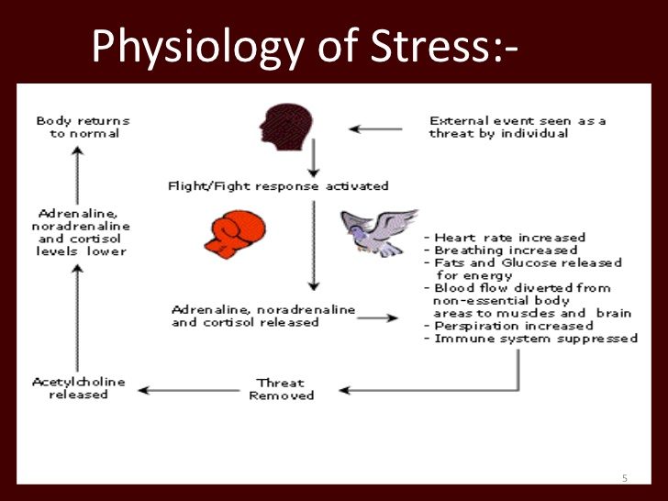
Blood pressure rises Breathing becomes more rapid Digestive system slows down Heart rate rises
When we are stressed

Slide 6

Academics: workload, challenging classes, packed schedule, studying
Social obstacles: making friends, independence, balancing life
Time management: organizing, deadlines, procrastination
Financial difficulties: university expenses, living cost, food costs
Other: sleep deprivation, jobs, unhealthy eating habits

Slide 7
Acute Stress It is usually for short time It may be due to work pressure, meeting deadlines pressure or minor accident, over exertion, increased physical activity, searching something but you misplaced it, or similar things. Symptoms of this type of tension are headaches, back pain, stomach problems, rapid heartbeat, muscle aches or body pain. Chronic Stress It is a prolonged stress that exists for weeks, months, or even years. This stress is due to poverty, broken or stressed families and marriages, chronic illness and successive failures in life. People suffering from this type of stress get used to it and may even not realize that they are under chronic stress. It is very harmful to their health.
Types of stress

Slide 8
Negative & Positive Stress: Eustress: Manageable Stress, can lead to growth and enhanced competence. Distress: Uncontrollable, prolonged, or overwhelming stress. It is destructive. Acute Stress: Immediate response to a threat or challenge. Chronic Stress: Ongoing exposure to stress, may seem unrelenting. Types of Stressors: External (physical environment, social interactions, organizational, major life events, daily hassles) Internal (negative self-talk, lifestyle choices, mind traps, personality traits)
Types of stress

Slide 9
SYMPTOMS OF STRESS
Acute
Chronic
Physical
Headaches/Migraines
Sweating
Nausea
Fatigue
Emotional/Cognitive
Worry
Anger
Irritability
Behavioral
Nail Biting
Restlessness/Fidgeting
Social Withdrawal
Interpersonal Conflict
Heart Diseases
Anxiety Disorders
Sleep Disorders
Depression
Weakened Immune System
Notes:
Acute – Before or during stressful situation
Chronic – Long-term stress

Slide 10
Eustress VS Distress
Eustress, or positive stress, has the following characteristics:
Motivates, focuses energy.
Is short-term.
Is perceived as within our coping abilities.
Improves performance.
Distress, or negative stress, has the following characteristics:
Causes anxiety or concern.
Can be short- or long-term.
Is perceived as outside of our coping abilities.
Feels unpleasant.
Decreases performance.
Can lead to mental and physical problems.

Slide 11
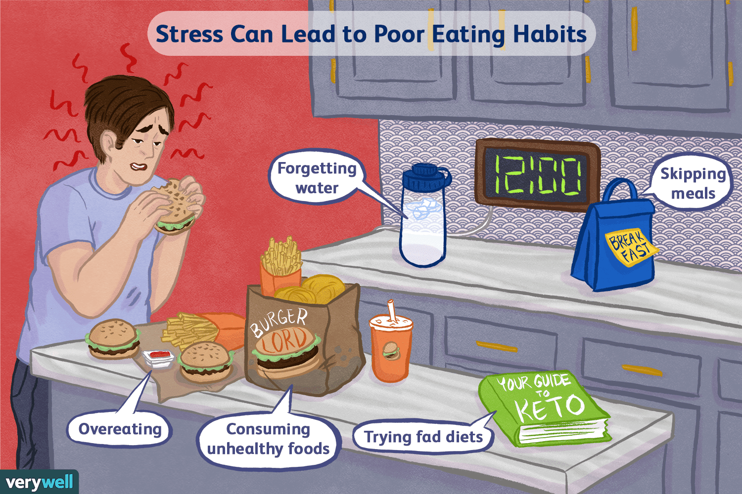

Slide 12



Time Management
Balancing responsibilities – SMART goals
Specific, measurable, achievable, result-oriented, time-oriented
To-do lists (Most to least important tasks) – Sense of accomplishment
Limit distractions – record, flight mode
Progress not perfection

Slide 13
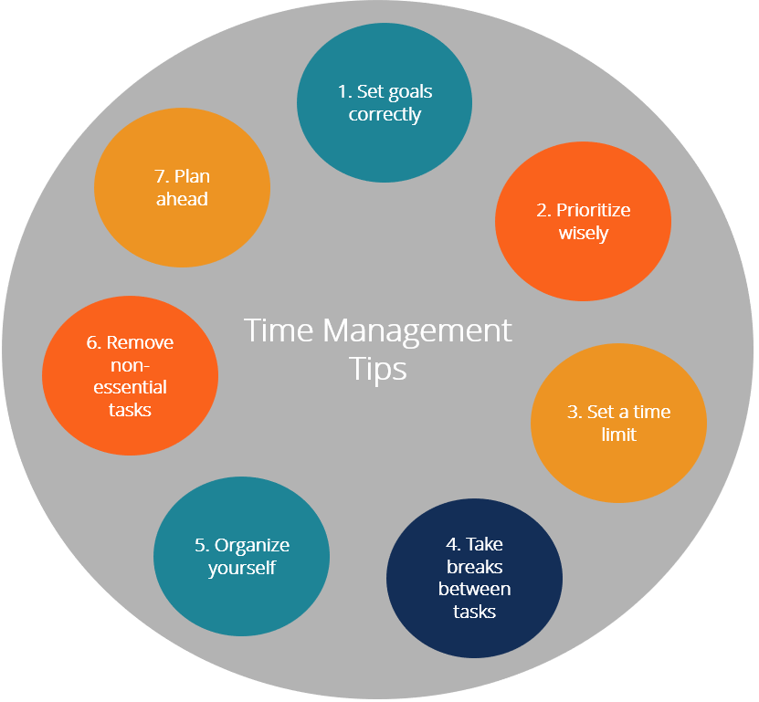

Slide 14
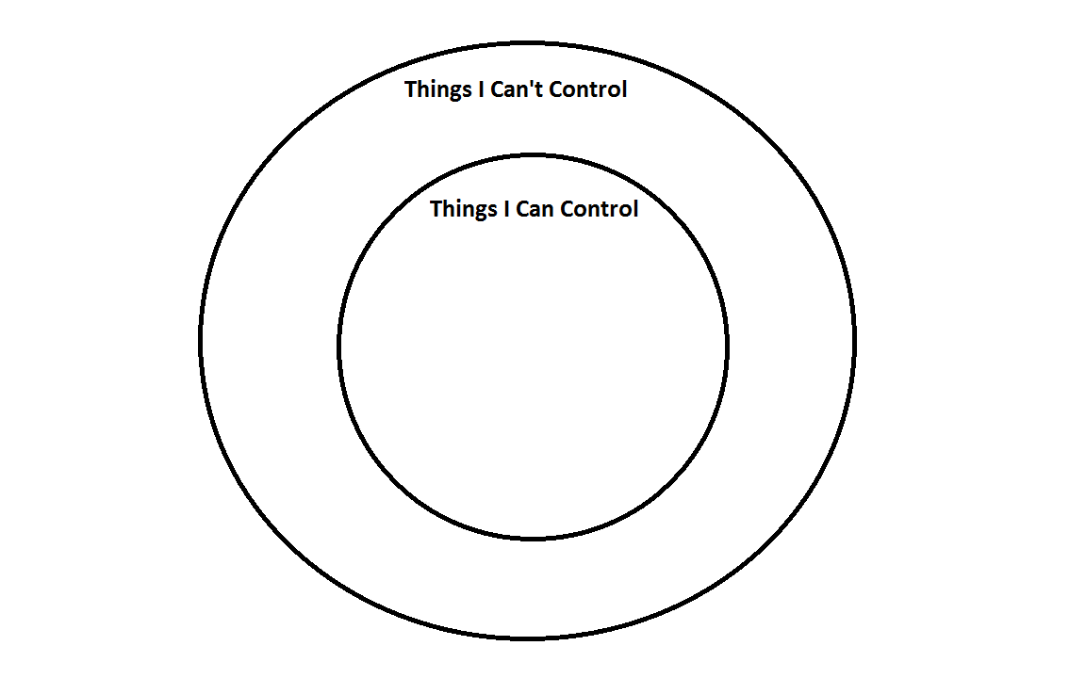

Slide 15
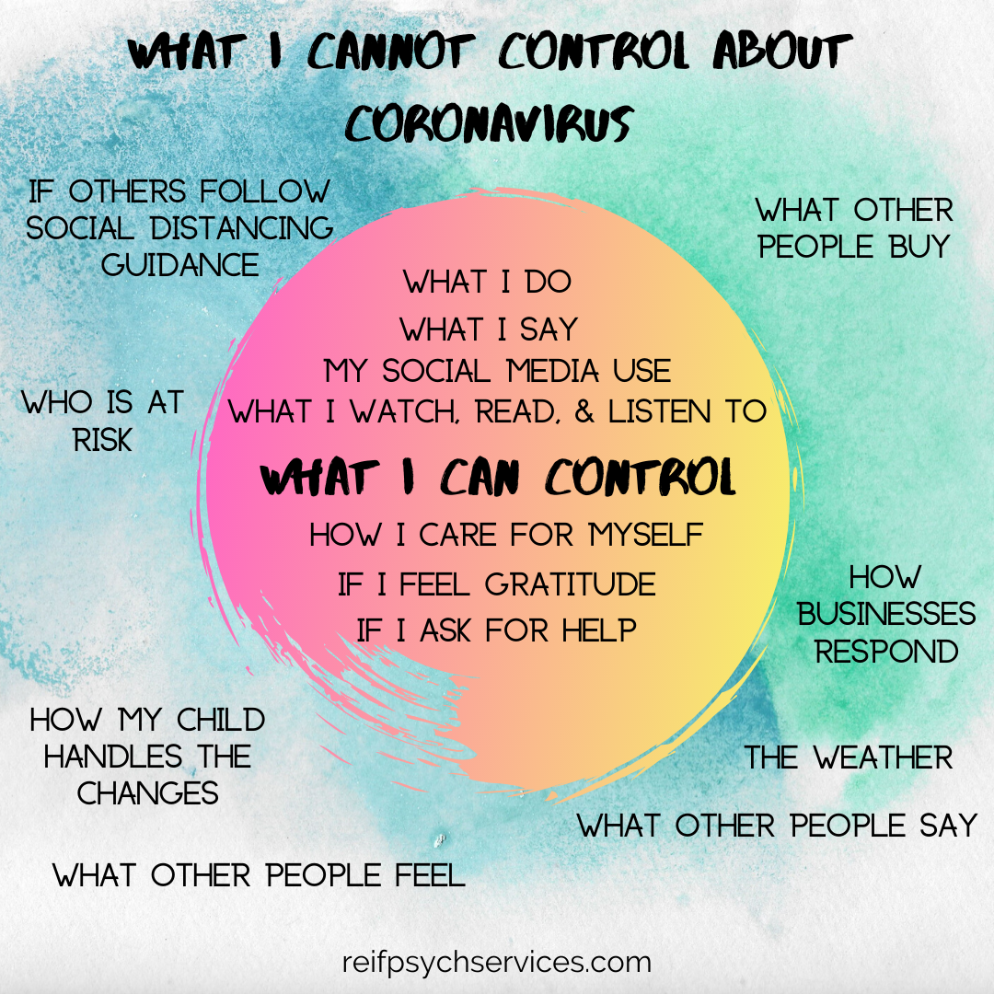

Slide 16

Repititive Prayers - Affirmations
Prayer is a very powerful tool that we have been blessed with
O Lord! Help me in dealing with the stresses of life. Give me wisdom, strength, and patience to deal with them affectively
Affirmation – It is a stressful situation and I am giving my best and that is what matters

Slide 17
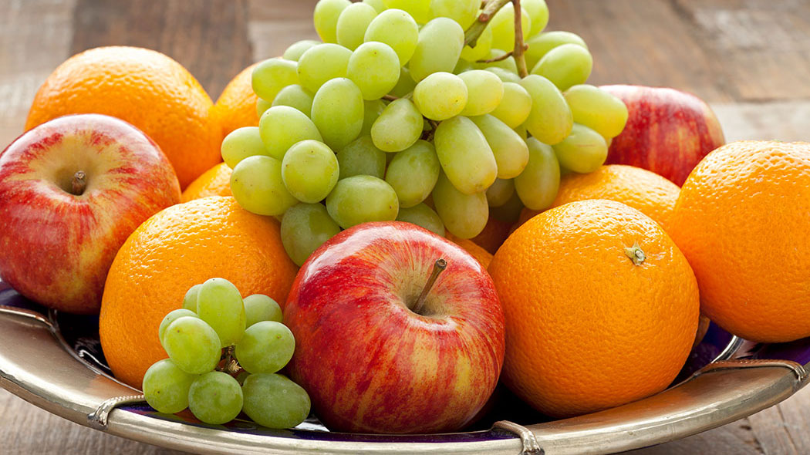
Self-care
Hobbies – Sports, reading, art, sitting under the sun and observing nature
Spend time with people you love
Taking bath is mandatory – once a day
Eat healthy food

Slide 18
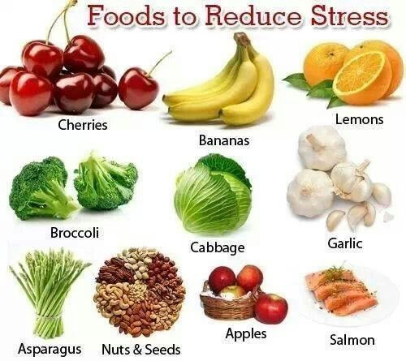

Slide 19
Deep Breathing
Sress – Fight and Flight response (sympathetic nervous system)
Deep breathing – Relaxation response (parasympathetic nervous system)
Focus awareness on your breath.
Breathe in deeply through your nose for four seconds (your lungs expand and your belly rises). Hold your breath for four seconds. And then exhale for four seconds
Heart rate slow
Feel more peaceful

Slide 20
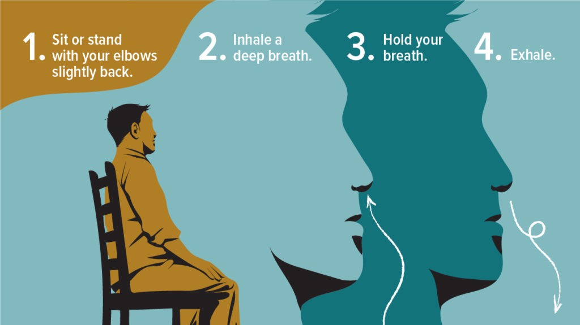

Slide 22
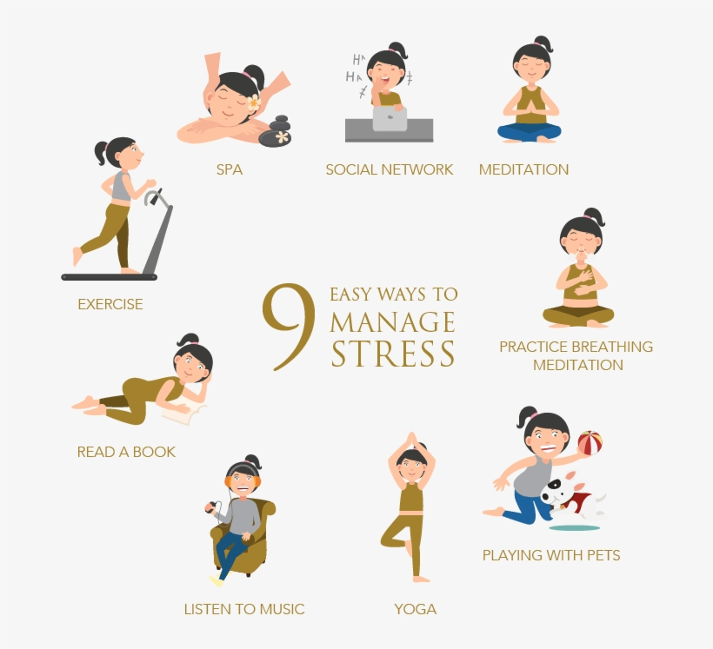

Slide 23
THANK YOU ANY QUESTIONS

